Slide 1
Canadian Planning Histories
A Brief Historical Overview of Planning in Canada

Slide 2
Learning Objectives:
Planning Contexts
Pre-Professional Planning:
Original Indigenous Communities
European Colonial Settlement
Urban Reform Movements
Post-Professional Planning:
20th Century
21st Century
Planning as a Profession
Canadian Institute of Planners (CIP)
Ontario Professional Planners Institution (OPPI)

Slide 3
The Context of Planning
It’s about change: A belief that change can be managed for the betterment of the community.
Planners argue about public good.
Shared sentiment that the human environment can be improved.
Historic connections between planning and landscape architecture, public health and architecture/urban design.
Planning is a political process – not objective or value free.
The way planners think is affected by the changing nature of society.

Slide 4
Canadian Evolution of Professional Planning
Mirrors major social currents of the times
Pre-Professional Times:
Original Indigenous Communities
European Colonial Settlement
Urban Reform Movements of the 19th Century
Post-Professional Times:
20th Century: World War I, Boom Times, Depression, World War II, Reconstruction, Great Expectations, Consolidation & Confrontation
The 80’s: Neo-Conservatism
The 90’s: Neo-Liberalism
21st Century

Slide 5
Canadian Evolution of Professional Planning: Pre-Professional Times
Original Indigenous Communities: Pre-Contact
European settlers only began to arrive about 500 years ago
Canada was already inhabited by Indigenous people
Connections to land - great detailed traditional ecological knowledge, local geographic and climate conditions
Knowledge passed on from generations to help communities survive across a vast landscape
People lived in more compact permanent settlements – Low Density Settlement Pattern, travelled to follow food sources, moved sites depending on time of year, availability of supplies
Some areas flourished agriculturally (land clearing, crop production) and were planned to include crop storage facilities and palisades to protect food supplies
Very much in harmony with the carry capacity of the territory

Slide 6
Canadian Evolution of Professional Planning: Pre-Professional Times
Colonial Settlement Planning: 15th-19th Centuries
Exploration, defence, food production
At odds with Indigenous peoples
European colonization wiped out evidence of Indigenous settlement patterns and laid foundation for contemporary landscape (i.e. the location of forts, ports, canals, railways)
Typically larger fortified bastide towns adjacent to good water supplies and arable land to farm
A geometry to these original land surveys – shaping the form of urban and rural landscapes: dimensions of urban blocks, patterns or land development and siting of facilities
Important aspect – transportation (railways) superimposed over these patterns, laid out in haste

Slide 7
Canadian Evolution of Professional Planning: Pre-Professional Times
Urban Reform Movements: 1890-1914
Laid the foundation for the planning profession
Reaction to congestion and squalor of industrial cities, exploitation of natural resources, speculative subdivision of suburban land, corrupt municipal governments
Health advocates = better understanding of germs, need for clean water, proper sanitation, fresh air, end of overcrowding of workers in dilapidated housing
Aided by other movements including sociological analysis of communities, parks and playgrounds movement, landscape architecture and North-American City Beautiful Movement

Slide 8
Canadian Evolution of Professional Planning: Pre-Professional Times
Urban Reform Movements: 1890-1914 (con’t)
Commission of Conservation: Est. in 1909, provided Canadian governments with scientific advice on conservation of human and natural resources, published these results, provided planning legislation for Canada, planning and zoning for Town extensions but not for re-planning of existing uses.

Slide 9
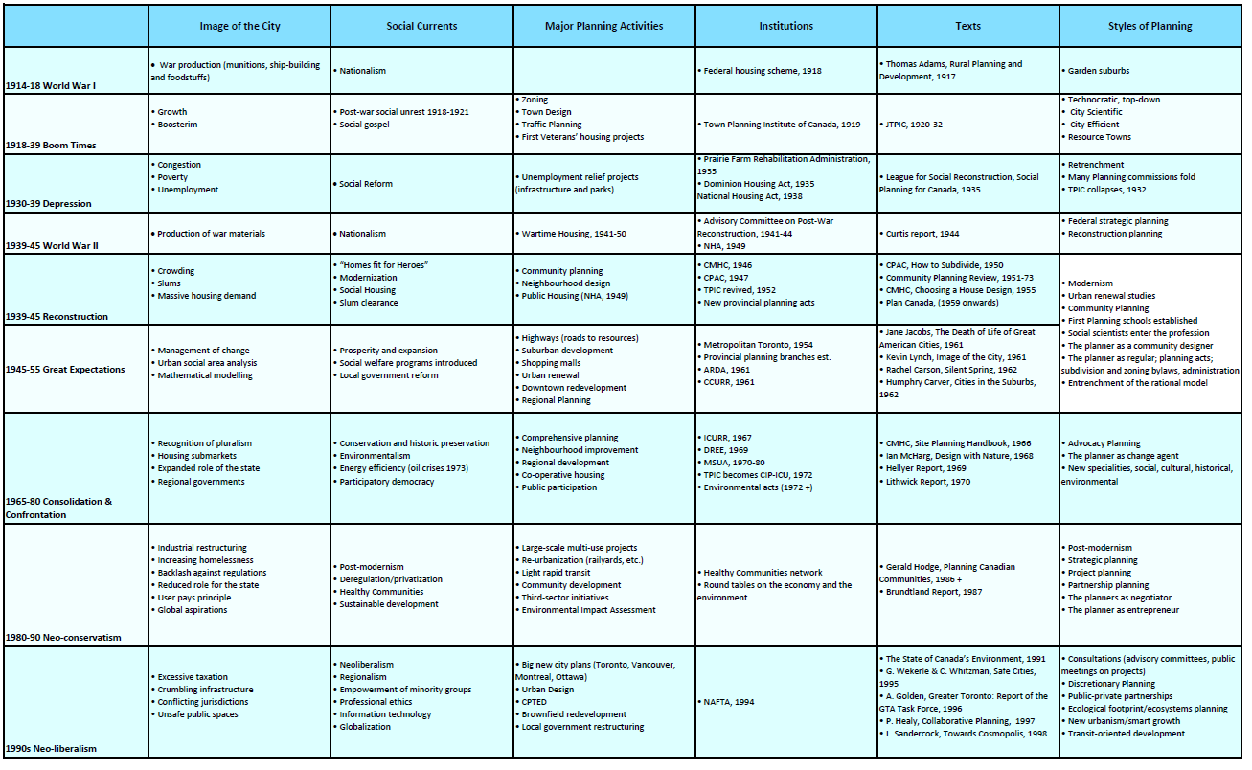
Canadian Evolution of Professional Planning: Post-Professional Times
20th Century

Slide 10
Canadian Evolution of Professional Planning: Post-Professional Times
20th Century Take Aways:
Role of Commission of Conservation continued, solidifying planning legislation and planning publications.
Town Planning Institute of Canada (TPIC): membership based professional organization
Cities established planning commissions for planning studies, zoning, town design and traffic planning
Published journals highlighted the virtues and economic necessity of planning and zoning and reported on planning progress all over the country, described overseas achievements in planning.

Slide 11
Canadian Evolution of Professional Planning: Post-Professional Times
20th Century Take Aways:
Three Main Events from the Depression (1930s)
Unemployment Relief Program: infrastructure construction - roads, bridges, waterworks, parks
Prairie Farm Rehabilitation Administration: spurred by drought, promoted soil and water conservation, good cropping practices, scientific irrigation.
Intro to Social Welfare: advocates for the poor, improvements to housing, overcrowding, juvenile delinquency, ‘Social Planning for Canada’ analyzing social conditions, prescribing health care, town planning, social housing. National Housing Act to make housing more affordable.
Post-War Reconstruction (after WWII, early 40s)– major national effort to undertake social improvement in housing, planning and public education.

Slide 12
Canadian Evolution of Professional Planning: Post-Professional Times
20th Century Take Aways:
Canada Mortgage and Housing Corporation (CMCH): promoted housing and planning, planning education and research, public awareness, direct lending to the public, municipal cost-sharing urban renewal, public housing, loans for sewage treatment, recruited planners and promoted a modernist layout and design.
Community Planning Association of Canada (CPAC): founded by CMCH, promoted planning ideas, brought together planning advocates who lobbied for new provincial legislation and municipal planning commissions, funding for universities, research and education.

Slide 13
Canadian Evolution of Professional Planning: Post-Professional Times
20th Century Take Aways:
Rapid urbanization and resource management (1940s) – creation of metropolitan and regional planning
Systemization of the planning process (50s & 60s)– use of scientific analysts and application of objective judgement to solve planning issues = Rational Method
Redevelopment of central areas for commercial or public purposes
Wide array of University planning programs
Environmentalism (60s & 70s): Consider impacts of a project before development – a new concept
Neo-Conservatism (80s-90s): industrial restructuring, job loss, increased crime rates, fiscal crises, globalization of the economy.
Re-Urbanization: Reuse old industrial districts or buildings (brownfields), railyards and former harbour lands for residential buildings, condos, offices, shops.
Sustainable Development: More global traction than environmentalism, led to policy changes, spurred global warming, climate change, ozone layer hole.

Slide 14
Canadian Evolution of Professional Planning: Post-Professional Times
20th Century Take Aways:
Neo-Liberalism & Globalization (90s): A context of deregulation, privatization, cost-recovery, government restructuring, profit over service and over equality of opportunity. Professional ethics became a major issue at the time.
New Urbanism: neo-traditional neighbourhoods (environmental, transit friendly) began to out perform conventional suburban developments. Transferred into cities where areas around major transit stations were identified as growth corridors for nodes of densification.
Smart Growth: combines inner city renewal, suburban retrofitting, regional infrastructure planning and protection of sensitive environments in rural areas. Emphasis on infrastructure efficiency and growth management, sometimes tied into watershed planning.

Slide 15
Canadian Evolution of Professional Planning: Post-Professional Times
21st Century
Images of the City: gentrified inner cities, suburban retrofitting, disaster recovery, resilient cities, smart cities.
Major Planning Activities: Transit planning, brownfield & greyfield redevelopment, active transportation, public housing revitalization, intensification & mixed use.
Planning Styles: Communicative & collaborative planning, sprawl repair/reurbanism, landscape urbanism, climate change mitigation & adaption, long-range scenario planning.

Slide 16
Planning as a Profession
Canadian Institute of Planners (CIP):
Works on behalf of over 7,000 planning professionals nationally as the voice of Canada’s planning community since 1909. Members work in both the public and private sectors across fields such as land use planning, environmental resource management, land development, heritage conservation, social planning, transportation planning and economic development. CIP advocates for planners nationally and internationally and provides membership services that help planners advance their careers.
Ontario Professional Planners Institution (OPPI):
The recognized voice of RPPs and the planning profession in Ontario, advocates for the best planning practices to inform choices and inspire communities in the public interest, OPPI has the mandate under the Ontario Professional Planners Institute Act to grant the RPP designation, govern the rights and responsibilities of its members, set academic, experience and examination requirements for membership. Not-for-profit, funded by membership fees, program and activity revenues.

